Slide 1
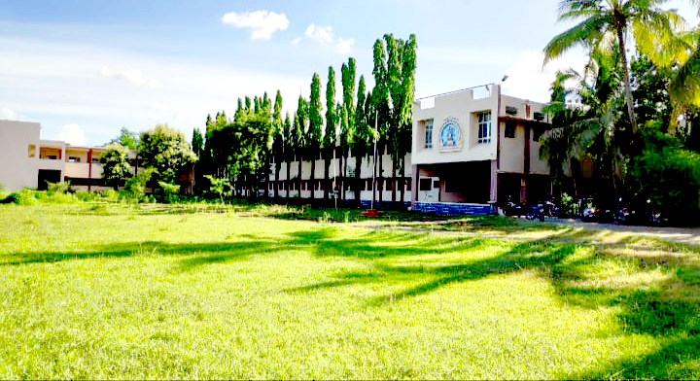

Welcome NAAC Peer Team
Date- 28 Oct. 2024 & 29 Oct. 2024

Slide 2

Pathri Taluka Shikshan Prasarak Mandal’s
Katruwar Arts, Ratanlal Kabara Science & B. R. Mantri Commerce College, Manwath TQ- Manwath Dist- Parbhani.
Profile
DEPARTMENT OF LIBRARY

Slide 3


KKM College, Manwath
2. Library at a Glance
Library at a Glance
Total No .of Books | 47141
No. of Periodicals | 35
Total No. of Dailies | 9(15)
Books
Sr .College | 36285
Jr. College | 9650
HSVC | 1206
Total | 47141
.
*Computerization Complted

Slide 4


3. Introduction of Department
K.K.M. College was formed in 1972 at the same time library also active with limited but all necessary books. Today there are more than 47141 books available, 35 periodicals, 15 newspapers has been coming in library continually. which these are referring senior college professor, Associate Professor, Asst. Professor, Junior College Teachers, all students and Non- teaching staff. There are many important text book, reference book available in library. But specially huge collection of Marathi, Hindi, English, Economics, Chemistry, Physics, Zoology. Library has made special arrangements for readers as per subject wise for college teaching staff and also seating arrangement for student. Library have special arrangement for biography, Novels and story collection. There is also golden collection of books as under

Slide 5

4. Golden Collection of KKM College, Library
Sr. No. | Title | No. of Volumes
1 | Indian Constituency Original Copy | 1
2 | Encyclopedia Britannica | 18
3 | Universal Encyclopedia | 30
4 | Encyclopedia Events 1976 – 1993 | 16
5 | Encyclopedia Scientific and Technical Terms | 14
6 | Encyclopedia of Indian Biography | 8
7 | Encyclopedia of Commerce | 5
8 | Encyclopedia of Medicine | 3
9 | New Junior World Encyclopedia | 9
10 | Wealth of India | 15
11 | Scientific and American Resource Library | 10
12 | Selected Jawaharlal Nehru | 15
13 | Sardar Patel Correspondence | 9
14 | 21st century Reference Dictionary | 2
15 | महात्मा गांधी संकलित वा:डमय | 25
16 | समग्र काका (काकासाहेब गाडगीळ) | 22
17 | विनोबा साहित्य | 21

Slide 6
4. Golden Collection of KKM College, Library
Sr. No. | Title | No. of Volumes
18 | इतिहासाचार्य वी.का.राजवाडे | 13
19 | स्वामी विवेकानंद ग्रंथावली | 10
20 | संपूर्ण महाभारत | 10
21 | चार वेद अठरा पुराण | 22
22 | समग्र लोकमान्य टिळक | 7
23 | आधुनिक महाराष्ट्राची जडणघडण (शिल्पकार चरित्रकोश ) | 7
24 | सार्थ वाल्मिकी रामायण | 4
25 | बोल महामानवाचे (डॉ.बी.आर.आंबेडकर ) | 3
26 | डायमंड अर्थशास्त्र कोश | 2
27 | समाजशास्त्र विश्वकोश | 2
28 | संस्कृत इंग्रजी शब्दकोश | 2
29 | ख्रिस्तपुराण | 1
30 | नोबेल पुरस्कार कोश | 1
31 | विविध विषयांचे शब्दकोश
32 | के. सागर यांचे स्पर्धा परीक्षेस उपयुक्त संदर्भ ग्रंथ
33 | PSI,STI,ITI IBPS साठी उपयुक्त संदर्भ ग्रंथ
34 | Back volumes (Renewal periodicals ) | 1709

Slide 7
5. Library Building
* Total Area 25 X 70 = 1750 Sq. Ft
* Librarian chamber 13 X 08 = 104 Sq. Ft
* Area of Issue Counter 05 X 10= 50 Sq. Ft
* Other teachers chambers- 06 Chambers
* Readers Chamber Area 10 X 06 = 60 Sq. Ft
* Reading Hall Area 450 Sq. Ft
6. Library Timing
* Monday to Friday 9:00 – 17:30
* Saturday 9:00 – 14:00

Slide 8


As per demand of students and teaching staff, text book, reference books and other literature for B.A. ,B.com,B.sc,M.com are to be provide them.
As per demand of students and teaching staff, text book and other literature for 11th and 12th Arts, Commerce , Science and Vocational Course are to be provide them.
To issue and return books, periodicals and journals among teaching, nonteaching staff and students of the college.
To provide the all library services as per demand of the readers.
To provide the books and other reading materials are to be issued to researchers and others
To provide the Marathi E-Novels Marathi Story, E-Story, Marathi E-Biography, Hindi E-Novels & other Hindi E-Literature & English Novels & other English
E-Literature.
7. Scope of the Library

Slide 9
8. Important of the College Library
College Library are depend on the institution of which they are part the role of the library information center in a college aimed at realizing the educational goals of college. They formulate their mission, vision and objective of their parent organization. They plan activities in congruence with plans of institution and the support the academic and research needs of student and faculty member of college. The college library provide reading materials to readers.

Slide 10

All required text books, reference books, periodicals and journals provide to the junior and senior teaching staff.
As per the requirement of all students fulfilled the all library services provide for compliance of their needs.
The library services has been also provide to external readers.
Library daily and annual work completed successfully.
Computerization of all books has been completed.
The library faculty has providing through computerized system.
In Library N – List 6000 E – Journals 97000 E – Books are Available in a Library.
Manifesto of Government of Maharastra Lokrajya Magzine issue to the Students free of cost from 2015 -2016 to -2018-2019.
Books Exhibitions was arranged in Each & Every academic Year 2017-2018 to 2022-2023
Extra Books Provided to the Students for project works.
Paper cuttings Services to Students & Staff as per Demands.
9. Achievement of Department in Brief

Slide 11
10. Future plan of library
1. As per need and consent of all junior and senior teaching staffs and students to order the text book, reference book other reading material, periodicals and journals.
2. To Start M.O.U. With 2 to 3 Colleges Library in this academic Year.
3. To undertake Minor Rsearch Paper in Library Science
4. To provide N-list E-Books & E-journals to Senior teaching staffs and students & Tell them Importance of this Recourse.
5. To give the necessary all reading materials to the readers.
6. Access Facilities N-List E-Books & E- Journals to the Students.
7. A Positive Strategy towards Green Library Implements.

Slide 12

K.K.M COLLEGE
MANWATH
DEPARTMENT OF LIBARARY
11.OPAC LINK
https://libcloud.mastersofterp.in/OPAC_V3/

Slide 13
1.Working time of library is 9 am to 5 :30 pm on working day. Saturday
time is 9 am to 2:00 pm .
2.In Academic Years 2018-19 to 2023-24 the Library organized 21 Book
Exhibitions.
3.The Book Review Competitions has been organized by Library in Academic Year 2023-24 & 2024-25
4. Set of text books service provide by library under S.A.F. skim to top scholar students of B.A & B.Com. also Jr. College Students.
5. Two Books are provided at a time two B.sc. Students. These facility also available who have optional English.
6. Special Compartment Facility is available Asst. Professors Associate Professors and Professors.
7. Library has applied extra Books Facility During the Exam Period with according to condition of specific deposit.
8. There is Facility of short open Library System available for Students.
9. Competitive Exam Center have been started for students.
12.Best Practices of K.K.M. College Library

Slide 14
12.Best Practices of K.K.M. College Library
10. Maharashtra Government Lokrajya Magazine is distributed to staff member & students at free a cost.
11. There is a Suggestion Box Facility available at Entry Gate of Library.
12. The Library General Rules are Placed at the Entry Gate of Library.
13. Library has Displayed Important Notice on Notice Board as per time to time in whole Year.
14. Librarian Dr. S. N. Chobe has been working as co-editor of Manwata Yearly issue of the College since 7 years .
15. University Examinations Internal marks are filled by Mr. S.A. Bochare
16. In every yearly camp of National Service Scheme Dr. S.N. Chobe delivers his speech on different issues.
17. Dr. S.N. Chobe has worked as an Yoga Teacher on the occasion of International Yoga Day on 21st June 2023 and 21st June 2024.

Slide 15



13. Books Purchase Report-2023-24.
K.K.M COLLEGE, MANWATH.
DEPARTMENT OF LIBRARY
Sr. No. | Year | Text Books | Reference Books | Total
1 | 2018-19 | 403 | 86 | 489
2 | 2019-20 | 903 | 170 | 1073
3 | 2020-21 | 797 | 185 | 982
4 | 2021-22 | 202 | 109 | 311
5 | 2022-23 | 315 | 110 | 425

Slide 16

14. Library Expenditure Report of. College
Year | Books | Subscription | Expenditure | News Papers | Total
2018-19 | 83168 | 14765 | 1740 | 10808 | 110481
2019-20 | 64133 | 24771 | 12481 | 17808 | 119193
2020-21 | 37283 | 7495 | 15670 | 14331 | 69779
2021-22 | 45798 | 16226 | 7960 | 13387 | 74779
2022-23 | 38166 | 21445 | 6200 | 19398 | 85209

Slide 17


DEPARTMENT OF LIBRARY
15. Books Transactions Report
Sr. | Books Transactions Members | Year | Total Transactions
1 | All Staff & Students | 2019-20 | 10241
2 | All Staff & Students | 2020-21 | 3305
3 | All Staff & Students | 2021-22 | 7432
4 | All Staff & Students | 2022-23 | 8592
5 | All Staff & Students | 2023-24 | 6484

Slide 18
K.K.M.COLLEGE, MANWATH.
DEPARTMENT OF LIBRARY
16. S.A.F DETAILS
Year | Class | Students | Total Books
2018-2019 | B.COM F.Y. | 24 | 84
2018-2019 | B.COM S.Y. | 20 | 99
2018-2019 | B.COM T.Y. | 15 | 52
2019-2020 | B.COM F.Y. | 38 | 124
2019-2020 | B.COM S.Y. | 24 | 102
2019-2020 | B.COM T.Y. | 27 | 95
2020-2021 | B.COM F.Y. | 32 | 88
2020-2021 | B.COM S.Y. | 23 | 65
2020-2021 | B.COM T.Y. | 25 | 72
2021-2022 | B.COM F.Y. | 36 | 98
2021-2022 | B.COM S.Y. | 28 | 83
2021-2022 | B.COM T.Y. | 25 | 90
2022-2023 | B.COM F.Y. | 38 | 135
2022-2023 | B.COM S.Y. | 29 | 122
2022-2023 | B.COM T.Y. | 28 | 125
2023-2024 | B.COM F.Y. | 22 | 88
2023-2024 | B.COM S.Y. | 16 | 86
2023-2024 | B.COM T.Y | 04 | 20
2024-2025 | B.COM F.Y. | 18 | 77
2024-2025 | B.COM S.Y. | 14 | 80
2024-2025 | B.COM T.Y | 06 | 38

Slide 19
Years | Class | Students | Total Books
2018-2019 | B.A.F.Y. | 20 | 86
2018-2019 | B.A.S.Y. | 22 | 77
2018-2019 | B.A.T.Y. | 17 | 72
2019-2020 | B.A.F.Y. | 24 | 88
2019-2020 | B.A.S.Y. | 19 | 82
2019-2020 | B.A.T.Y. | 20 | 90
2020-2021 | B.A.F.Y. | 21 | 85
2020-2021 | B.A.S.Y. | 18 | 66
2020-2021 | B.A.T.Y | 15 | 70
2021-2022 | B.A.F.Y. | 22 | 65
2021-2022 | B.A.S.Y. | 20 | 90
2021-2022 | B.A.T.Y | 14 | 68
2022-2023 | B.A.F.Y. | 21 | 88
2022-2023 | B.A.S.Y. | 18 | 84
2022-2023 | B.A.T.Y | 19 | 62
2023-2024 | B.A.F.Y | 22 | 96
2023-2024 | B.A.S.Y. | 09 | 39
2023-2024 | B.A.T.Y | 06 | 36
2024-2025 | B.A.F.Y | 14 | 58
2024-2025 | B.A.S.Y. | 07 | 35
2024-2025 | B.A.T.Y | 06 | 33

Slide 20
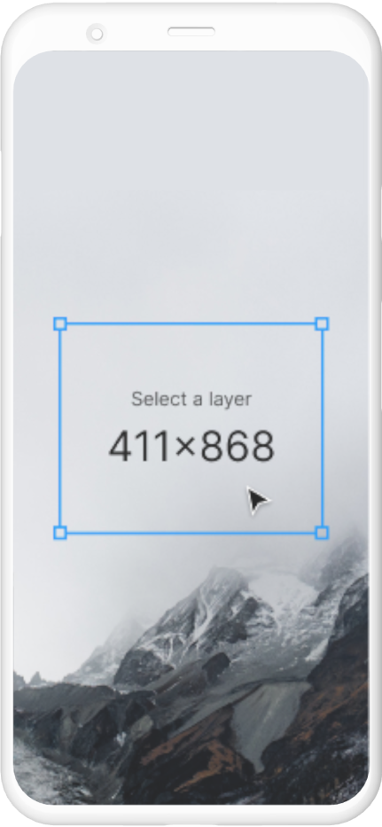

17. Book Exhibition At a Glance
Sr.No | Exhibition | Date
1 | General Books | 04/01/2019
2 | General Books | 09/01/2020
3 | Marathi | 28/01/2022
4 | Physical Education | 24/01/2023
5 | Shivaji Maharaj Jayanti | 19/02/2023
6 | Hindi | 28/02/2023
7 | English | 03/03/2023
8 | Sociology | 10/03/2023
9 | Political Science | 27/03/2023
10 | History | 31/03/2023
11 | Chemistry | 22/08/2023

Slide 21
17. Book Exhibition At a Glance
Sr.No | Exhibition | Date
12 | Botany | 26/08/2023
13 | Economics | 05/09/2023
14 | Zoology | 12/09/2023
15 | Physics | 26/09/2023
16 | Mathematics | 12/10/2023
17 | Commerce | 26/10/2023
18 | Hari Shankar Parsai Shatabdi Special (Hindi) | 27/10/2023
19 | Computer Science | 30/10/2023
20 | Marathi | 15/01/2024
21 | General Books M.L.A Vikram Kale Donated | 28/01/2024
22 | Dr. APJ. Abdul Kalam | 14/08/2024

Slide 22
K.K.M COLLEGE
MANWATH
DEPARTMENT OF LIBRARY
18. BOOK RIVIEW COMPETITION REPORT
Academic Year-2023-2024
The book review competition was conducted in the second semester in the academic year 2023-24 On 31/01/2024 this notice was sent to all the groups of the college. Their names were called till 14/02/2024. After that forward was given to the students about the method to be analyzed in this competition. A total 25 students registered for this competition. Out of them, nine students registered through direct method. They submitted their review by directly participating in the book review competition. In order to successfully conduct this competition. Principal Dr. Bhaskar Munde Sir and IQAC Coordinator Dr. Durgesh Ravande render invaluable support.
On the 23th April 2024 the Winners of this competition were given certificates and books in the prize distribution function. Conducted in the Library.
Book Review Competition Result
Sr.No | Name of the Student | Class | Rank
1 | Dhopte Jayshri | B.A.T.Y | 1ST
2 | Kabra Anuja | B.A.T.Y | 2nd
3 | Mundada Vidhi | B.A.T.Y | 3rd
4 | Kakde Shital | B.A.T.Y | 3rd

Slide 23

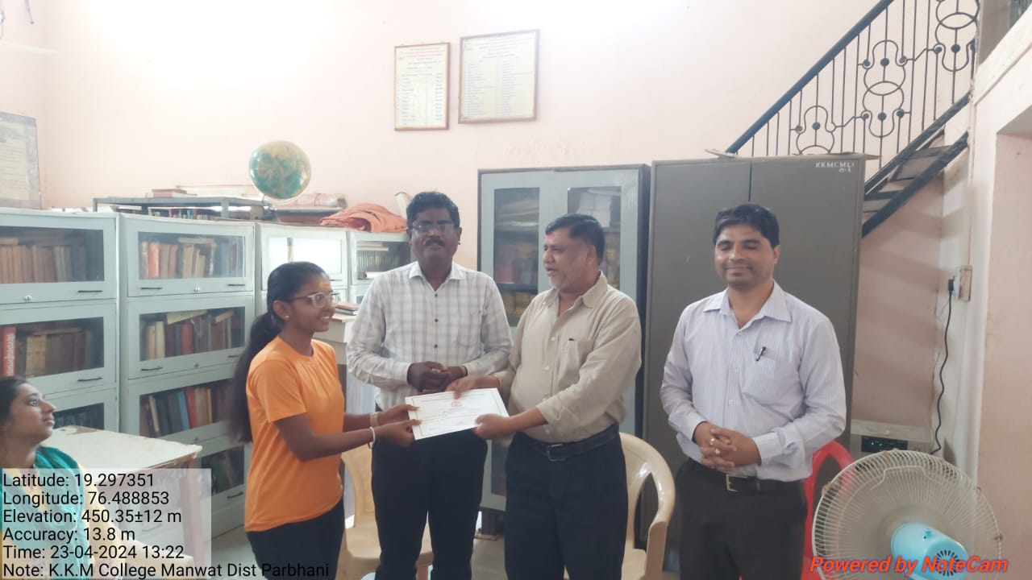
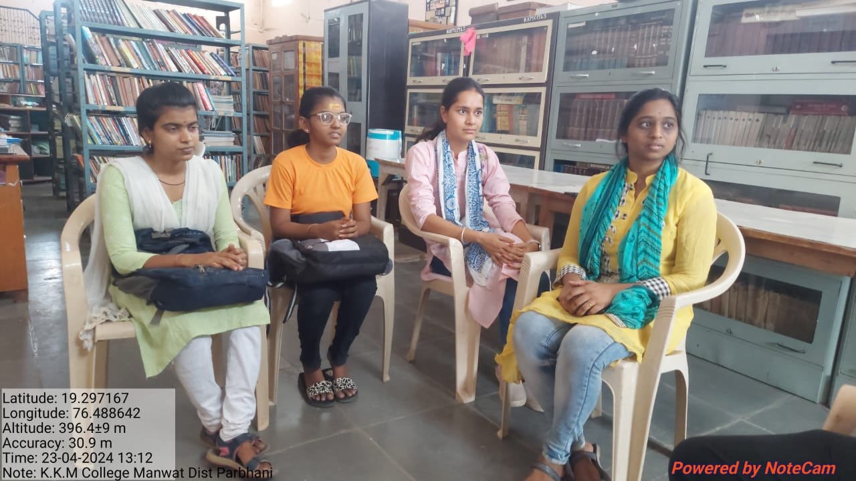
Dr. S.N Chobe
Librarian
K.K.M College Manwath

Slide 24
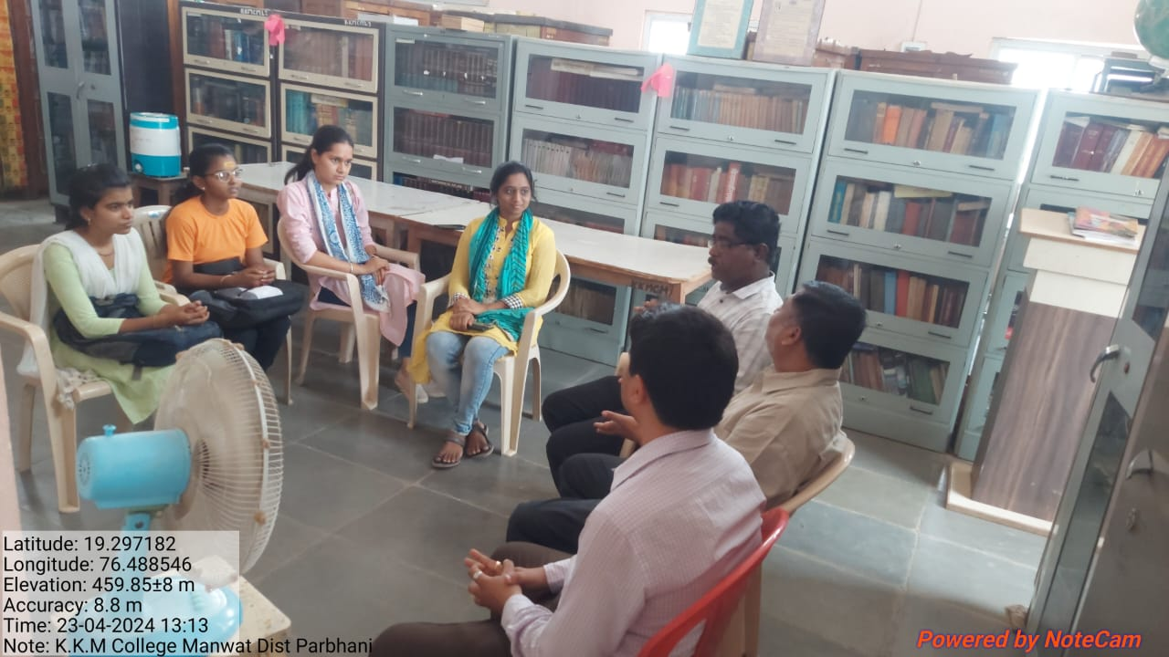
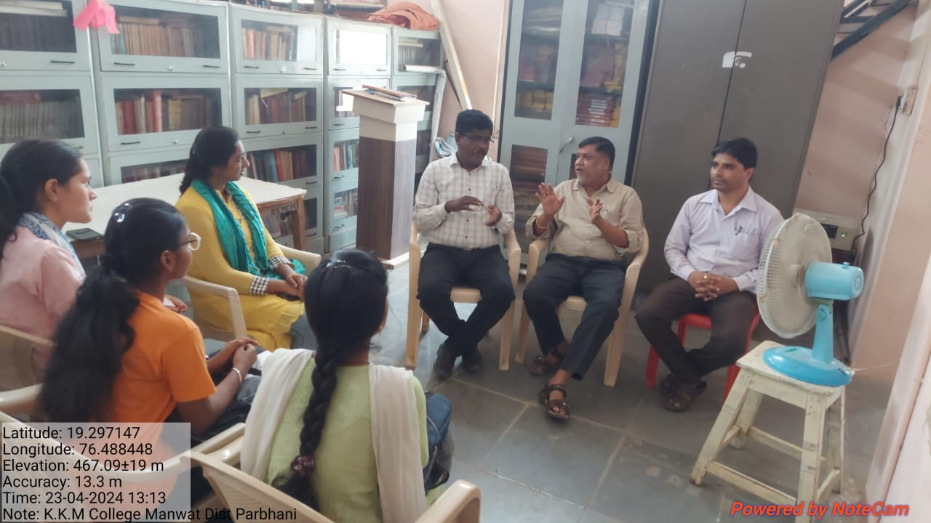
Dr. S.N Chobe
Librarian
K.K.M College Manwath

Slide 25
K.K.M.COLLEGE, MANWATH.
DEPARTMENT OF LIBRARY
19. Reading Room Visitors
Sr. | Reading Room Visitors | Year | No. of Visitors
1 | Student Visitors | 2017-18 | 1175
2 | Student Visitors | 2018-19 | 1400
3 | Student Visitors | 2019-20 | 1748
4 | Student Visitors | 2020-21 | 900
5 | Student Visitors | 2021-22 | 2288
6 | Student Visitors | 2022-23 | 2250
7 | Student Visitors | 2023-24 | 2440

Slide 26
KKM College
Dept. of Library
20. Periodicals / Journal List
Sr.No. | Name | Type | Subject
1 | Akshargatha | Quarterly | Marathi
2 | Satyagrahi Vichardhara | Monthy | Marathi
3 | Samyayog Sadhana | Weekly | Marathi
4. | Maharashtra Sahitya Patrika | Quarterly | Marathi
5. | Alochana | Quarterly | Hindi
6 | Arthsanvad | Quarterly | Economics
7 | Bhartiya Itihas ani Sanskriti | Quarterly | History
8 | Sanshodhak | Quarterly | History
9 | Chanakya Mandal | Monthly | Political Science
10. | Lokrajya | Monthly | Political Science
11. | Samaj Prabodhan Patrika | Quarterly | Sociology
12. | Shikshan Ani Samaj | Quarterly | Sociology
13 | Saptahik Sadhana | Weekly | Sociology

Slide 27
KKM College
Dept. of Library
20. Periodicals / Journals List
14 | Economics and Political Weekly | Weekly | Commerce
15 | Yojna | Monthly | Commerce
16 | Vyapari Mitra | Monthly | Commerce
17 | Resonance | Monthly | Physics
18 | Bulletin of Marathwada Mathematical Society | Half Yealy | Mathematics
19 | Current Science | Monthly | General Science
20 | Competition Success Review | Monthly | Competitive Exam
21 | Competition Affairs | Monthly | Competitive Exam
22 | Shikshan Sankraman | Monthly | Journals
23 | Saptahik Sakal | Weekly | Journals
24 | University News | Weekly | Journals
25 | Employment News | Weekly | Journals
26 | Om Shanti Media | Fortnightly | Journals
27 | Dipawali Issue | Yearly | Journals
28 | Nav Anushtubh | Two Monthly | Marathi
29 | Saptahik Vivek | Weekly | Journals

Slide 28
KKM College
Dept. of Library
21. Faculty wise Periodicals and Journals
Sr. No. | Name of Faculty | No. of Periodicals and Journals
1 | Arts | 17
2 | Commerce | 04
3 | Science | 04
4 | Generals | 09
5 | Competitive Exams | 02
 | Total | 35

Slide 29
KKM College
Dept. of Library
22. Newspaper
Sr.No. | Name of the Newspaper | No.of Newspaper | Language
1 | Lokmat | 3 | Marathi
2 | Loksatta | 3 | Marathi
3 | Sakal | 3 | Marathi
4 | Punya Nagari | 1 | Marathi
5 | Agro one | 1 | Marathi
6 | Deshonnati | 1 | Marathi
7 | Pudhari | 1 | Marathi
8 | Indian Express | 2 | English
 | Total | 15

Slide 30
23. No. of Books & No. of Titles (Genral category )
Sr. No | Fuculty | Name of the Subject | No. of Books | No. of Titles
1 | Arts | Economics | 3521 | 1342
2 | Arts | Hindi | 879 | 440
3 | Arts | History | 2771 | 1097
4 | Arts | Marathi Literature | 1597 | 891
5 | Arts | Political Science | 2522 | 924
6 | Arts | Sociology | 1702 | 588
7 | Arts | English | 3999 | 2403
8 | Arts | Geography | 45 | 45
9 | Arts | Journalism | 4 | 3
10 | Arts | Psychology | 25 | 17
11 | Arts | Philosophy | 2 | 2
12 | Arts | Physical Education | 44 | 44
13 | Arts | Public Admistration | 22 | 15
14 | Arts | Sanskrit | 14 | 4
15 | Science | Biology | 1097 | 292
16 | Science | Botany | 575 | 366
17 | Science | chemistry | 1595 | 631

Slide 31
23. No. of Books & No. of Titles (Genral category)
18 | Science | Computer Science | 601 | 223
19 | Science | Physics | 2938 | 971
20 | Science | Zoology | 481 | 280
21 | Science | Mathematics | 2131 | 580
22 | Science | Ecology | 14 | 9
23 | Science | Information Technology | 60 | 2
24 | Commerce | Commerce | 2425 | 695
25 | Law | Law | 79 | 51
26 | Accountancy | Accountancy | 176 | 17
27 | MCVC | MCVC | 540 | 80
28 | ELECTRONICS | ELECTRONICS | 884 | 284
29 | General | General | 4165 | 3219
30 | Library Science | Library Science | 20 | 20
31 | Crop Science | Crop Science | 23 | 12
32 | Law | Law | 83 | 52
33 | Enviroment | Enviroment | 132 | 62
34 | Genral | Genral | 4165 | 3219
 |  | TOTAL | 39331 | 18880

Slide 32
24. No. of Books & No. of Titles
(Donated Category)
1 | Science | Botany-Donated | 2 | 2
2 | Science | Chemistry- Donated | 22 | 21
3 | Arts | English - Doneted | 87 | 70
4 | Arts | Hindi- Donated | 380 | 352
5 | Arts | History- Donated | 32 | 32
6 | Science | Physics- Donated | 12 | 3
7 | Science | Zoology -Donated | 3 | 3
8 | Arts | Political Science- Donated | 9 | 8
9 | Arts | Sociology-Donated | 14 | 13
10 | Genral | Genral | 41 | 40
 |  | TOTAL | 602 | 544

Slide 33
25. Important Shortcuts
Sr. No | Digital Archives of Periodicals Shortcuts
1 | 1.Gyanamrit 2. Kishor, 3.Lokrajya 4.Om Shanti Media 5. Shikashan Sankraman 6.The World Renewal 7. Weekly Sadhana
2 | News Papers Shortcuts-22

Slide 34
26. All E-books PDF Format Subject Wise List
Sr. No | E-books Subject | Number of Title
1 | Marathi Novel | 40
2 | Marathi Poetry | 08
3 | Marathi Story | 16
4 | Marathi Biography | 04
5 | Marathi Essay | 01
6 | Other Marathi E-books | 03
7 | Hindi Novel | 22
8 | Hindi Poetry | 06
9 | Hindi Story | 06
9 | Other Hindi E-books | 29
10 | Hindi Biography | 08
11 | Hindi Essay | 02
12 | English Novel | 24
13 | English Poetry | 05
 | English Story | 07
14 | Other English E-books | 18
15 | English Autobiography | 05
16 | English Essay | 02
 | Total | 206

Slide 35
K.K.M.COLLEGE, MANWATH
DEPARTMENT OF LIBRARY
In our Library N-list E-books & E-Journals Available
Sr. No. | Description | No. of E-Books & E-Journals
1 | N-list E-Books | 46000
2 | N-list E-Journals | 1625

Slide 36
K.K.M.COLLEGE, MANWATH
DEPARTMENT OF LIBRARY
Library Staff
27. Former Library Staff
Sr.No. | Name of the Person | Designation | Date of Joining | Date of Retirement
1. | Late. Mr. N.B. Kulkarni Retired | Librarian | 21/07/1972 | 31/01/2011
2. | Mr. J. V. Kurwadkar Retired | Library Clerk | 01/11/ 1972 | 30/08/ 2009
3. | Mr. S. S. Nakhate, Retired | Library Attendent | 01/06/1978 | 31 /03 /2014
4. | Mr. Dhabadage Retired | Peon | 01/06/1978 | 30/08/2015

Slide 37
28. Faculty available in a Brief (Library Staff)
Sr.No. | Name of the Person | Designation | Date of Joining | Qualification
1 | Dr. S. N. Chobe | Librarian | 15/02/2013 | M.Lib.Ph D.
3 | Mr. S. A. Bochare | Library Clerk | 5/05/2009 | M.LIB.
2 | Mr. A. S. Mitkari | Library Attendant | 01/09/2022 | M.Com
4 | Mr. V. S. Gundale | Peon | 31/10/2006 | B.A.

Slide 38
29.LIBRARY FURNITURE AND OTHERS
SR. NO. | NAME OF THE FURNITURE | NO. OF QUANTITY
1 | Wooden Steel Cupboards | 65
2 | Open Steel Racks | 30
3 | Mini Open Steel Rack | 01
4 | Wooden Cupboards | 02
5 | Godrej Steel Cupboards | 10
6 | Godrej Office Cupboards | 03
7 | Wooden Tables | 15
8 | Wooden Chairs | 10
9 | Office Tables | 02
10 | Office Chairs | 02
11 | Fiber Chairs | 10
12 | Computers | 4
13 | Inverters | 01
14 | Inverters Batteries | 02
15 | Tubes | 15

Slide 39
29. LIBRARY FURNITURE AND OTHERS
16 | CFL Bulbs | 04
17 | Ceiling Fan | 12
18 | Table Fan | 01
19 | Wooden Stool | 06
20 | Wooden Fine Box | 01
21 | Wooden Book Card Box | 04
22 | Book Stand | 01
23 | Periodicals Stand | 01
24 | Earth Round | 01
25 | Notice Boards | 02
26 | Letter Stands | 01
27 | Intercom | 01
28 | Fire Extinguisher | 01
29 | Suggestion Box | 01
30 | Wall Fan | 02

Slide 40
30. Reading Room Furniture
SR. NO. | NAME OF THE FURNITURE | NO. OF QUANTITY
01 | Big Wooden Tables | 05
02 | Small Wooden Tables | 07
03 | Fiber Chairs | 36

Slide 41
31. CD List in Library
Tuz Aahe Maz Pasi 1
Ms Office 2003 Bible 1
The Algorithm Design Manual 1
Foxconn 1
Tax Computation on CD 2005 1
Amazing Tools for Electronics 1
English Phonetics and Phonology (I) 1
English Phonetics and Phonology (II) 1
Comdex Computer Course Kit 1
Cambridge English Pronouncing Dictionary 2
Genetics Student CD-Rom 1
Dr.Babasaheb Ambedkar 1
Prism 9
Computer Fundamentals. (Acc.No. 33697-33600) 4
(Acc.No. 33670-33690) 21
Mastering Word 2000. (Acc.No. 33723-33729) 7
Computer Programming and Data Structures (36867-36868) 2

Slide 42
31. CD List in Library
Aazadi se Jiye 33942 1
Comdex Computer Course Kit 34318 1
Mastering HTML 4 34417 1
Visual Basic 6 34418 1
Genetics 34502 1
JAVA Script 35000-02 3
HTML, DHTML, Java Script, Perl, CGI 35007 1
VB Script 35009-35012 4
Prism 35106-35110 5
Mastering Visual Basic 6 35285-35292 8
SQL,PL/SQL 35439-35443 5
Multimedia Magic 35453 1
Upgrading and Repairing PC’s 35867-35870 &35879 5
MBA-CET 36208 1

Slide 43
31. CD List in Library
Oracle 9i PL/SQL Prog. 36882 1
Spoken English 36890 1
Comdex Hardware and Networking Course Kit 36923- 1
RBI Annual Report ……….2006-07 1
RBI Annual Report ……….2007-08 1
RBI Annual Report ……….2008-09 1
RBI Annual Report ……….2010-11 1
RBI Report on trend and progress
Banking in India …………..2007-08 1
RBI Report on trend and progress
Banking in India …………..2008-09 1
RBI Report on trend and progress
Banking in India …………..2010-11 1

Slide 44
31. CD List in Library
Navya Vaibhavachi Swapne Sajavi
Avinash Dharmadhikari Yanchi Katha Mala 14
Discrete Mathematics (Complete Guide) 1
Java A very fast way to learn 1
Data Structure A very fast way to learn 1
C- Rapid 1
Visual Basic 6.0 A very simple way to learn 1
VB.NET A very simple way to learn 1
C ++ A very fast way to learn 1
Modern ABC of chemistry 38865 1
Total 128

Slide 45
The College Has given the conference hall for Yoga Dhyandharana Camp to Art of Living Branch Manwath
for Fourteen times without any charge.
32. K.K.M.COLLEGE, MANWATH
Sr. No. | From Date | Till Date | For Purpose
1 | 9/12/2021 | 21/12/2021 | Yoga Dhyandharana Camp
2 | 16/09/2022 | 21/09/2022 | Yoga Dhyandharana Camp
3 | 5/10/2022 | 10/10/2022 | Yoga Dhyandharana Camp
4 | 28/10/2022 | 01/11/2022 | Yoga Dhyandharana Camp
5 | 03/05/2023 | 08/05/2023 | Yoga Dhyandharana Camp
6 | 31/05/2023 | 05/06/2023 | Yoga Dhyandharana Camp
7 | 05/07/2023 | 10/07/2023 | Yoga Dhyandharana Camp
8 | 25/07/2023 | 30/07/2023 | Yoga Dhyandharana Camp
9 | 09/08/2023 | 13/08/2023 | Yoga Dhyandharana Camp
10 | 17/04/2024 | 22/04/2024 | Yoga Dhyandharana Camp
11 | 13/05/2024 | 19/05/2024 | Yoga Dhyandharana Camp
12 | 14/06/2024 | 19/06/2024 | Yoga Dhyandharana Camp
13 | 17/07/2024 | 22/07/2024 | Yoga Dhyandharana Camp
14 | 10/08/2024 | 15/08/2024 | Yoga Dhyandharana Camp
15 | 16/10/2024 | 21/10/2024 | Yoga Dhyandharana Camp

Slide 46
33. K.K.M.COLLEGE, MANWATH
DEPARTMENT OF LIBRARY
Librarian Dr. Sachin Chobe Academic & Research Contribution in Assessment NAAC Period.
Sr. No. | Description | No. of Course /Paper Presentation/ Academic Contribution
1 | Refresher Course | 2 Times
2 | Short Term Course | 1 Times
3 | Research Paper Published in Journals | 7 Times
4 | Research Paper Published in Book Chapter | 6 Times
5 | Paper Presented in International & National Conference | 9 Times
6 | Without Paper Presentation Workshop Contribution | 3 Times
7 | In every Year Yearly Camp of NSS Dr. Sachin Chobe Delver his Speech on Different Issue. | 4 Times
8 | Dr. Sachin Chobe Worked as Yoga Teacher on the occasion of International Yogaday in our College | 2 Years
9 | Dr. Sachin Chobe Worked as Cap officer for S.R.T.M. University Examination Academic Year 2020-21 & 2021-22 | 2 Years
10 | Dr. Sachin Chobe Worked as Member of Different Committee such a library Committee, Katariya Prize Distribution Committee, Manvata Ank Committee, Publicity Committee & Debate Committee | 5 Years

Slide 47
Thank You

